Slide 1

IPL ANALYSIS 2008 – 2025
BUSINESS REQUIREMENTS
The objective of this project is to create an interactive Power BI dashboard that provides insights into the performance of teams across IPL seasons from 2008 to 2025.
Primary KPI’s
The objective of this project is to create an interactive Power BI dashboard that provides insights into the performance of teams across IPL seasons from 2008 to 2025.
A key business requirement is to enable users to select any season using a slicer/filter and instantly view:
The Winner Team of the selected season along with its dynamically displayed team logo
The Runner-Up Team of the selected seasen along with its dynamically displayed team logo

Slide 2
IPL ANALYSIS 2008 – 2025
BUSINESS REQUIREMENTS
Secondary KPI’s
A key business requirement is to enable users to select any season using a slicer/filter and instantly view:
Total Sixes
Total Fours
Total Matches Played
Total Teams Participated
Total Centuries
Total Half-Centuries
Total Venues Used

Slide 3
IPL ANALYSIS 2008 – 2025
BUSINESS REQUIREMENTS
Season Stat’s
A key business requirement is to enable users to select any season using a slicer/filter and instantly view:
Orange Cap Stats
Orange Cap Holder Name
Total Runs Scored in the season
Team Name the player represented
Player Image (dynamically rendered)
Purple Cap Stats
Purple Cap Holder Name
Total Wickets in the season
Team Name the player represented
Player Image (dynamically rendered)
Total Fours in Season
Player Name
Total Fours in the season
Team Name the player represented
Player Image (dynamically rendered)
Total Sixes in Season
Player Name
Total Six’s in the season
Team Name the player represented
Player Image (dynamically rendered)

Slide 4
IPL ANALYSIS 2008 – 2025
BUSINESS REQUIREMENTS
Points Table
When a specific season is selected via a slicer/filter, display a Points Table that includes the following dynamic fields for each team:
Logo | Team Name | Matches Played | Won |Lost |No Result | Tie |Total Points
Logo: Dynamic team logo
Team Name: Official name of the IPL team
Matches Played: Total matches played by the team in the selected season
Won: Number of matches won
Lost: Number of matches lost
No Result: Matches with no result (e.g., rain-affected)
Tie: Matches that ended in a tie
Total Points: Calculated using standard IPL points rules:Total Points = (Wins x2) + (Ties x1) + (No Results x 1)

Slide 5
Power BI Projects

Slide 6
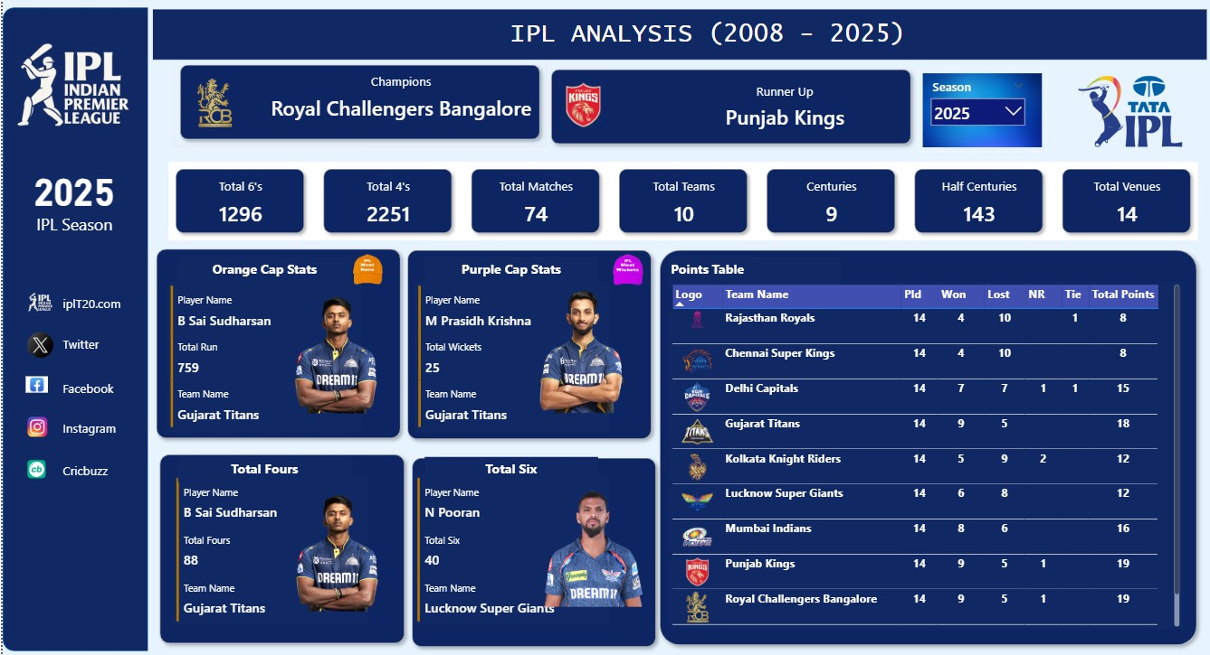

Slide 7
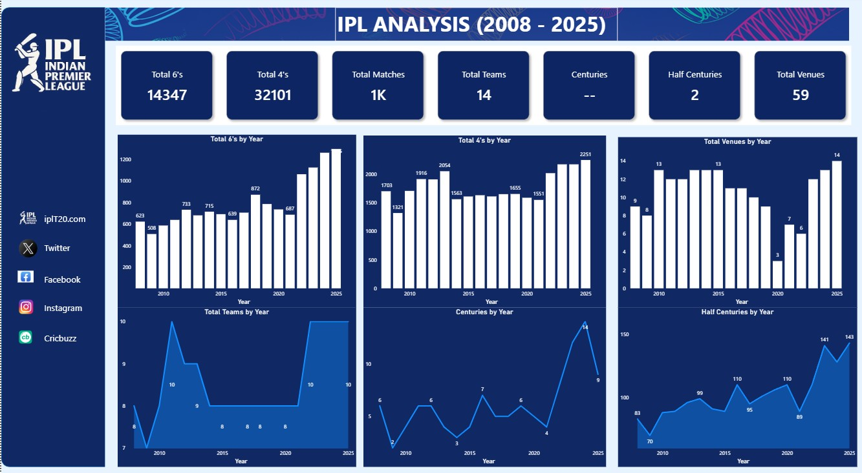

Slide 8
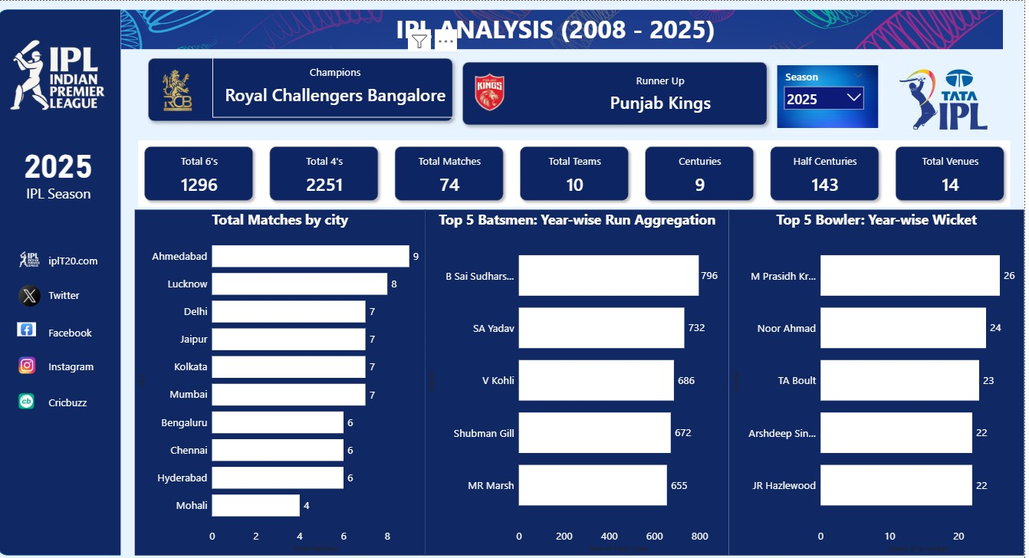

Slide 9




THANKS
Do you have any questions?
girwarsinghrathore4@gmail.com
+91 7976285430
https://github.com/Girwarbanna
This Photo by Unknown Author is licensed under CC BY

